Slide 1
2020-21 PACKAGING & ESTIMATES TRAINING
January 22, 2020
Joy Scourey

Slide 2
Topics for today:
Review of Packaging Plans & Timelines
Changes to Undergraduate, Resident Packaging
Specifics of Washington College Grant & Navigation in myWSU
Reminders for WCG and other groups
Cost of Attendance
Grant funding Groups & Other funding outside of grants
Financial Aid Estimates
Estimates troubleshooting
Tools & Resources

Slide 3
2020-21 Packaging Plans
FA21.01 | WASFA Undergraduate
FA21.03 | Undergraduate Post-Bac
FA21.04 | Resident Undergraduate On Time
FA21.05 | Resident Undergraduate Not on Time
FA21.06 | Non Resident Undergraduate On Time
FA21.07 | Non Resident Undergraduate Not on Time
FA21.11 | Graduate
FA21.21 | MBA
FA21.31 | Medical
FA21.41 | Pharmacy
FA21.51 | Vet Med
Notes:
Packaging redesign project to separate out undergraduate careers to reduce the complexities of how current the current packaging process was built.
This will assist with troubleshooting issues with packaging and transition much of the set-up to be done by SFS versus ES.
Plan is for there to be a snapshot page for staff to see what criteria (EFC, MFI, Residency, Career, etc) was used when student was packaged

Slide 4
2020-21 Target Packaging Timelines
Monday, February 3rd, 2020 | Monday, February 10th , 2020 | Monday, February 24th, 2020
Group 1 | Group 2 | Group 3
Vet Med & Pharmacy | Undergraduate: Non Resident on time and not on time & Resident Need, Not on Time | Resident Undergraduate On Time - Institutional Grant Eligible, Cougar Commitment Eligible
MBA & Graduate Students | Post Bac | Medical Students

Slide 5
Undergraduate Resident On Time Packaging
  Washington College Grant eligibility expanded to 100% MFI and no deadlines to receive WCG apply if student qualifies, see chart below.
  WCG MFI ranges of 55%-65%, eligible for College Bound Award, MFI ranges of 70%-100%, entitled to WCG award but no CB award.
  Students who are Pell Eligible and or WCG at MFI range of 70% or lower are eligible for Cougar Commitment grant.
  Students receiving only WCG at MFI of 70% or higher are eligible for an Institutional Grant based on MFI range below:
    75% MFI – eligible for $3500
    100% MFI – eligible for $2500
  Resident Undergraduate Students who are not eligible for Pell Grant and or Washington College Grant, with an EFC of 12,000 or lower, who meet all institutional deadlines, will be awarded funding based on the Institutional Grant awarding chart.

Slide 6
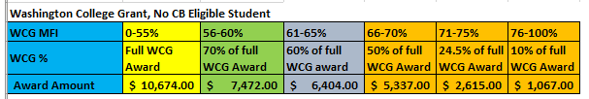
Washington College Grant Awarding Chart

Slide 7
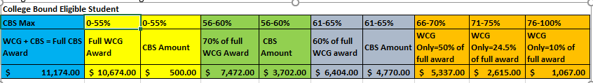
Washington College Grant & CB Awarding Chart

Slide 8
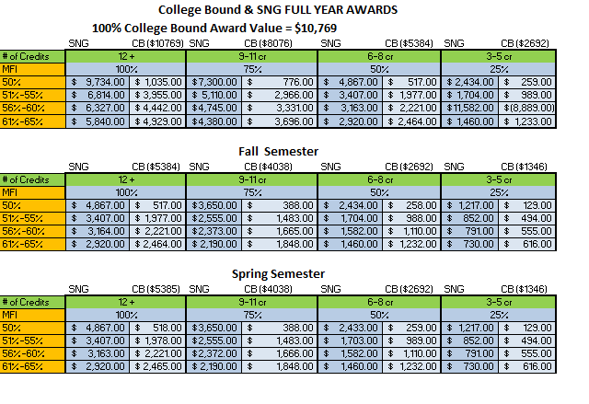
State Need Grant Chart

Slide 9
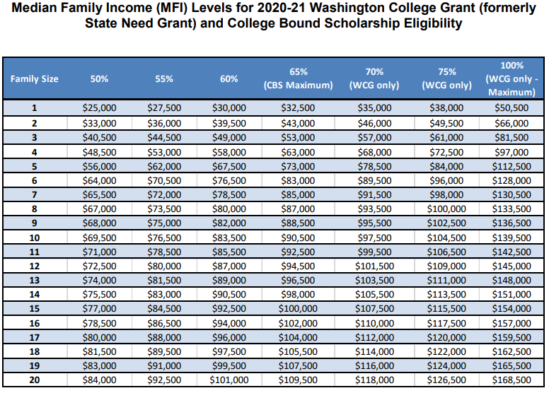
Median Family Income Levels Chart

Slide 10
State Need Grant
State Need Grant Information in WSU Pages section
First Tab = SNG/CB Status
2nd Tab = SNG Calculations (Awarding Levels) & MFI

Slide 11
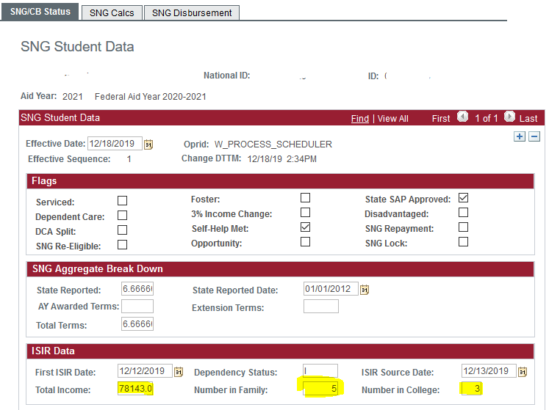
Where to see MFI in myWSU
Notes:
Total Income = Parents AGI = Total Untaxed Income

Slide 12
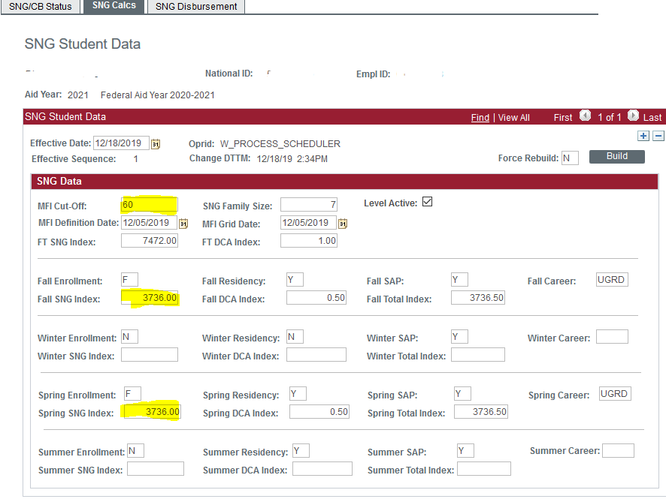
Calculated MFI
Calculated Award based off term enrollment

Slide 13
Family Size for More Than One Family Member in College
Increase the family size by one for every family member who will be in college beyond the first, excluding parents (e.g. A family of five with two non-parents in college is treated as a family of six on the income MFI chart; a family of five with three non-parents in college is treated as a family of seven). Information on family size typically comes from the FAFSA or WASFA.

Slide 14
How Income Levels are Determined
In most cases, use the income reported on the FAFSA or the WASFA.
When calculating family income for a “dependent” student, count the parents’ Adjusted Gross Income (AGI) and non-taxable income. Do not include the student’s income.
When calculating family income for an “independent” student, count the student’s AGI and non-taxable income, and that of the spouse (if the student is married). 27
For both dependent and independent students, if the AGI is not present (i.e., parent/ student is not a tax filer), use the sum of all taxable plus non-taxable income.

Slide 15
CB & WCG Eligibility Infor….
WCG – 10 terms of Eligibility
CB – 8 terms of Eligibility
Other reasons a student might not be packaged for these funding types:
  Student has less than 3 terms of eligibility remaining.
  For CB, student has exhausted the 5 year eligibility after h.s graduation, for 20-21, student who graduated 2014-15, this applies.
  Student has graduated
  Student does not meet SAP
Remember, other checks are ok to award and ok to pay; common reasons why no ok to pay would be final transcript not recorded.

Slide 16
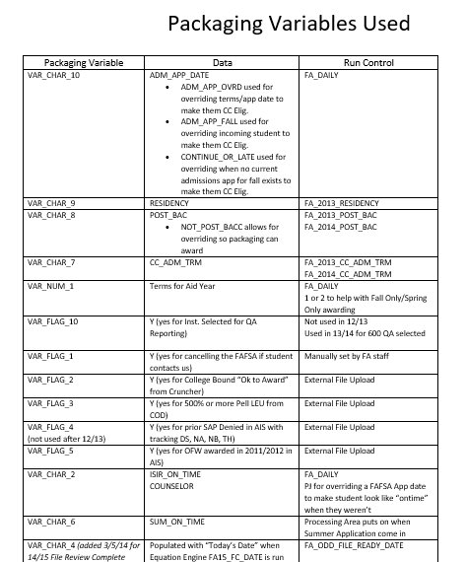
Packaging Variables

Slide 17
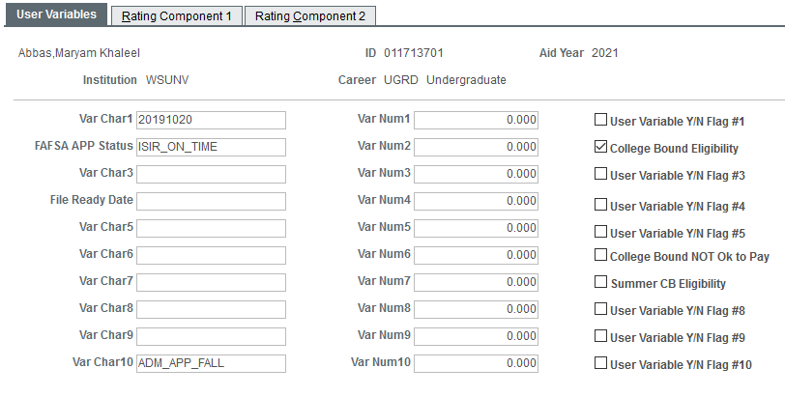
Packaging Variables

Slide 18
Reminders with Expansion of WCG Program
Institutional deadlines do not apply to receive WCG and or CB.
Even if receiving WCG or Pell Grant, deadlines will apply for institutional funding sources.
College Bound eligible students at an MFI range above 65% will receive their WCG award eligibility, but no College Bound Award.
Students only receiving Washington College Grant based on MFI levels of 75% - Flat $3500 Institutional Grant Award
100% - Flat $2500 Institutional Grant Award
Students only receiving WCG at MFI levels below 70% - awarded Cougar Commitment funding based on their campus.

Slide 19
Packaging Reminders for other Groups
No changes for Non Resident Undergraduates, On Time or Not on Time
On Time, Resident Undergraduates, not Pell or WCG eligible, w/EFC below 12,000 – same awarding parameters for Institutional Grant.
Graduate & VetMed students are budgeted with a Resident cost-of-attendance because the majority end up receiving a non-resident fee waiver/graduate fee waiver.
Graduate students receiving a Graduate Fee Waiver for spring 2020, will be packaged with the same placeholder for 2020-21.
Online MBA students:
  OMBA – fulltime = 5 credits (1/2 time = 3 credits) Program –D5500
  EOMBA – fulltime = 10 credits (1/2 time = 5 credits) Program –D5505

Slide 20
Cost of Attendance/Budgets
Navigation to view budgets:
  Finaid.wsu.edu > Cost of Attendance > Tuition & Expenses
  Mywsu > main menu > financial aid > budgets > maintain term budgets
  Mywsu> main menu > financial aid > awards > award processing > assign awards to a student > need summary (tab)
  Also knowledge base tab – Cost of Attendance Budgets
2020-21 Estimated Cost-of-Attendance- using current year actual tuition and fees in place (source used is from the WSU Budget Office website)
Tuition and fees will not be finalized until mid spring
New Service Indicator now in place to hold a refund if a student has a double budget.

Slide 21
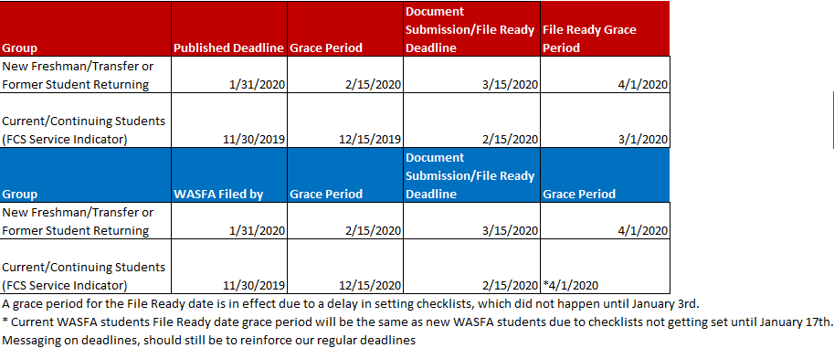
2020-21 On-Time Dates for equity funding that applies

Slide 22
Grant Funding Groups
Cougar Commitment
Institutional Grant
Refer to On-Time Dates chart
Washington State Resident
Pell & or WCG eligible (up to 70%)
Refer to On-Time Dates chart
Washington State Resident
EFC below 12,000
Not Pell Eligible
WCG eligible (70%-100% MFI)

Slide 23
Awards outside of Cougar Commitment and Institutional Grant
Scholarships
Other resources such as waivers, TPG’s
Work Study
Subsidized Direct Loan
  Need Requirement
Unsubsidized Direct Loan
Parent PLUS
Private Loans

Slide 24
Financial Aid Estimates
Tutorial of the Estimates Portal
Navigation of tabs
As soon as a student has a financial aid package in myWSU, they will be directed to view their awards there.
Current Stats of Estimates as of today: 8179
  Pullman – 7224
  Vancouver – 594
  Tri-Cities – 217
  Global – 112
  Everett – 27
  Spokane - 5

Slide 25
Estimates Reminders
Estimates are only provided to incoming undergraduate students who have a FAFSA on file.
Pullman students must be in an admitted status to receive an Estimated Package, all other campus’s, students must have applied for admission.
Students with awards posted in myWSU, will have these be included in the Estimates package.
The Estimates data is run once a day. If a FAFSA loads after this process, an Estimate won’t generate until the next day.
If the student needs to submit documents, there will be a tab (listed first) on their Estimates page, directing them to the submitsfsdocs.wsu.edu site. If no documents, needed, this tab will not appear.
As students submit documents, the document requested will no longer show up on the portal site as long as it’s showing as received in myWSU.
The tab called “Your Financial Need” provides details on the student’s campus, residency, cost-of-attendance and EFC.
This information is dynamic: As students are verified and if packaging information changes, the Estimated Package will be updated.
We still have not received finalized 2020-21 Pell Charts and therefore current year values are being used. When we receive this information, the charts will be updated and Pell awards reflected correctly for these Estimates

Slide 26
Packaging Scenarios
Student Information
Cost-of-attendance
Dependent
Freshman
WA resident
Pullman Campus
Applied on time – VAR Char 1
Supplied documentation on time
Var Flag #2
Pell eligible
  EFC = 0
WCG eligible
  MFI = 50%
Total: $28,190

Slide 27
Student’s Package……
Requirements
Awards
Dependent
Freshman
WA resident
Pullman Campus
Applied on time
Supplied documentation on time
Pell eligible
  EFC = 0
SNG eligible
  MFI = 55%
SEOG = $100
SNG Pell Grant = $6,195
= $10,674
College Bound = $500
Subsidized Loan = $3,500
Unsubsidized Loan = $2,000
Parent PLUS = $5,221
Total: $28,190

Slide 28
Packaging Scenario
Requirements
Cost-of attendance
WA resident
Vancouver Campus
Applied on time
Missed File Ready Date
Pell eligible
  EFC = 5125
WCG Eligible
  MFI = 70%
Total: $26,902

Slide 29
Student’s Package
Requirements
Awards
Dependent
Sophomore
WA resident
Pullman Campus
Applied on time
Missed File Ready Date
Pell eligible
  EFC = 5125
WCG eligible
  MFI = 70%
Pell Grant = $1,045
WCG = $5,337
Subsidized Loan = $4,500
Unsubsidized Loan = $2,000
Parent PLUS = $14,020
Total: $26,902

Slide 30
Packaging Scenario
Requirements
Cost-of-attendance
Dependent
Sophomore
WA resident
Tri-Cities Campus
Applied on time
Supplied documentation on time
Not Pell eligible
  EFC = 11,050
Not WCG eligible
  MFI = NA
Total = $27,114

Slide 31
Student’s Package
Requirements
Awards
WA resident, Dependent
Tri-Cities Campus
Applied on time
Supplied documentation on time
Not Pell eligible
  EFC = 11,050
Not WCG eligible
  MFI = NA
Inst Grant = $600
Subsidized Loan = $4,500
Unsubsidized Loan = $2,000
Parent PLUS = $20,014
Total = $27,114

Slide 32
Packaging Scenario
Requirements
Cost-of-attendance
Wa resident
Independent, Junior
Pullman Campus
Met All Deadlines
No Pell Eligibility, EFC 6000
CB eligible
WCG eligibility – 70%
$28,190

Slide 33
Student’s Package
Requirements
Awards
Wa resident
Independent, Junior
Awarded Crimson Transfer Awd
Pullman Campus
Met All Deadlines
No Pell Eligibility, EFC 6000
CB eligible
WCG eligibility – 70%
Crimson Transfer Awd - $2000
WCG Award - $5,337
Institutional Grant - $3,500
Subsidized Loan - $5,500
Unsubsidized Loan - $7,000
Total - $23,337

Slide 34
Packaging Scenario
Requirements
Cost-of-attendance
WASFA Student
Awarded the Vancouver AA
Dependent
Vancouver Campus
Did not meet FAFSA priority date
No verification needed
EFC – 3000
CB Eligible & MFI – 60%
$26,902

Slide 35
Student’s Package
Requirements
Awards
WASFA Student
Awarded the Vancouver AA
Dependent
Vancouver Campus
Did not meet FAFSA priority date
No verification needed
EFC – 3000
CB Eligible & MFI – 60%
Vancouver AA - $3000
WCG Award - $7,472
College Bound Award - $3,702
Total = $14,174

Slide 36
Reminders……..
Regardless of institutional deadlines, if the student is eligible, they will receive:
  Federal Pell Grant (if only receiving non federal/state aid, can be overawarded)
  Washington College Grant (WCG)
  Washington College Bound Scholarship (CB)
  Federal Loans
  2020-21 awarding levels for Pell Grant, WCG, and CB have not been finalized.
  Common reasons why a student will be repackaged are due to changes to:
  EFC or MFI
  Residency
  Career
  Campus
  PJ

Slide 37
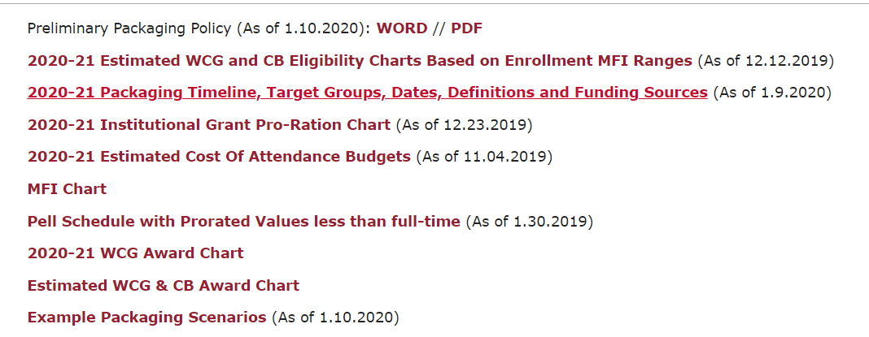
Tools & Resources
SFS 411>Packaging Section>2020-21 Packaging Information:

Slide 38
Questions
.

